Slide 1
Post Covid Webinar Presentation
“The New Normal’’

Slide 2
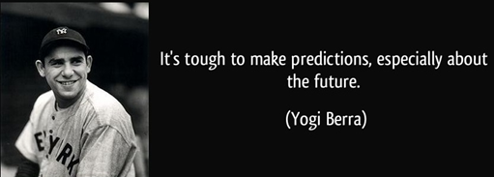

Slide 4
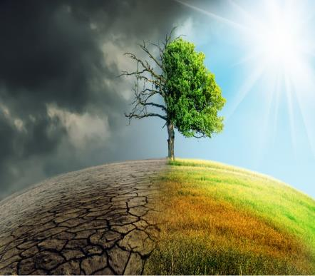
Covid-19 Impact Questions:
Our customers & consumers
OPCO’s & brands
How dramatically will the world change?
For whom?
Where, when and how?
In what areas of their lives?
For how long?
What will the impacts on them be?
What will consumers & customers new functional and emotional needs be
Impact on our OPCO’s, brand portfolio’s?
Brand positioning, communication, activation?
How does this impact innovation?
What are the implications - opportunities and risks?
What do we do about it to ensure we accelerate growth in the post Covid world

Slide 5
Covid 19 Impact Timeline
Pre Covid
Covid Lockdown
Post Lockdown Release
Post Covid New Normal
Reset and Reframe
Health Impact – Incidence, Therapeutics & Vaccine dependent
Socio Economic Impact – Will take longer to re-build post Release period
Survival and Self Reflection
Emotional Release vs Rational Caution
Adjusting to a new future
Reprioritising, developing new habits
Fear
Isolation
Resilience
Re-evalutaion of what’s important
Virtual life embedded
Emotional release from Crisis Fatigue – extreme behaviour or heightened experiences.
Cautious reintegration into world:
Lingering Covid fear
Facing financial reality
Continuing new habits vs re-adoption of old
Adapting to new world
Returning to Normal or moving forward to the new normal.
What to take with to the new world and what to leave behind.
Adopting new habits
Stage Characteristics

Slide 6
Covid’s will have a broad impact on consumer psychographics, needs and behaviours
Covid19 Impact
Resultant Impact
Resultant Impact
Resultant Impact
Demographics
Age
Income
Gender
Culture
Nature/Nurture
Environment
Life Experience
Social and functional Trends
Psychographics
Values
Beliefs
Attitudes
Needs
Functional
Emotional
Behaviours
Social
Shopping
Brand
Media
=
=
=
=
O&L Portfolio Implications.
What do we need to continue, change or create across the marketing mix - product, positioning, communication, price, promotion in order to accelerate sustainable growth in the post Covid world?

Slide 7
Covid Namibian Societal Impact
Self
Altruism
Self-Worth
Esteem
Status, self-esteem, confidence, achievement, respect
Love & Belonging
Family, Friendships, Community and intimacy
Physiological
Food, health, sleep basic amenities and utilities
Safety
Self and family, property, resources, employment
Re-evaluating Priorities
Post Covid
Fear of falling back
Pre Covid
Post Covid
Need support to survive

Slide 8
We will need to understand the impact on our key consumer segments…
Go Getta
Go Getta
Go Getta
Born Privileged
Established Traditional’s
Survivors
True Blue
Family Anchor
Professional Elite’s
SOCIODEMO
Life Starter
Young Professional
LSM 1-4
LSM 5-6
LSM 7-8
LSM 9-10
Men
Women
North
Kavango&Zambezi
Central
Coastal
Working
Not Working
Student
15-17 years
18-24 years
25-29 years
30-39 years
40+ years
Average age
22 | 28 | 22 | 28 | 28 | 43 | 39 | 41
n=214
n=103
n=174
n=139
n=98
n=143
n=126
n=132
S02 ,S03 Gender, S05 Age, S06b Employment, S08: Category Interest L4
Base: All respondents (Drinkers)

Slide 9
And how it changes their values, attitudes, behaviours and needs.
Go Getta
Go Getta
Go Getta
Born Privileged
Established Traditional’s
Survivors
True Blue
Family Anchor
Professional Elite’s
Life Starter
Young Professional
Young female students, who are very shy and reserved/ respectful.
They are generally happy with what they have but admit that it’s a struggle. They focus on their individual needs and are fashionable.
They would like to experience new things life has to offer and drink a top quality brand when they can afford it and prefer brands with tradition and history.
Confident male who is outgoing and confident.
Not shy of taking risks and individual focused. They are the first to adopt technology and other trends.
Family is important to them as well as their beliefs. Always on social media, updating their profiles.
Image is important and keeping up with appearances and trends - Living it up.
Mix gender, 18-24 years, LSM 9-10. (Live with parents who have money).
Drink to have fun and not as an escape from their struggles (don’t really have struggles!).
Not show off’s but will drink top quality brands. They don’t care about tradition. Outward focused
Males, late 20's, working.
Religious beliefs are what define them. They don't care about partying, fashion, appearances or trends - they lead simple lives and like to be in control.
Want to better their lives
Mixed gender, 25-29 years, middle class.
They are traditional in honouring their culture but will have fun ONLY at home where no one can see and where they can loose control.
They will drink to help de-stress (escape struggles)and will stick to the same brand.
40’s, equal gender, working but also not working.
Older in their way of thinking, not open to new things. Want to provide for their family and be healthy. Its all about what they have accomplished.
Keep to what they like and know with a focus on taste and time to appreciate their drinks. They are shy and drink to boost their confidence and admit to drinking on their own.
Mix of gender, LSM 9-10, 30+ Years, working.
Providing for family is important to them, not interested in appearances, trends or fashions.
Not brand/status sensitive but have money.
Confident in social situations. Drink to relax but don’t loose control.
Religion isn't important to them.
Males, working, 30+ years, LSM 9-10 but also some LSM 7-8's.
Use computer (probably at work), trend watcher and influencer.
Likes to party and will take risks.
Is a trendy person (likes to look nice and has sophisticated tastes).

Slide 10
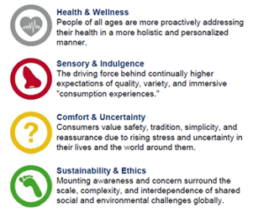
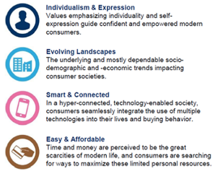
Covid’s impact on trends will lead to a range of opportunities and risks
Existing Trends
Starts
Implications
Covid 19
Impact
Health and wellbeing
Economic
1
2
Accelerates or Expands
Opportunities and Risks”
Portfolio
Brands
Innovation
Communication
Engagement
Trends
3
Trends clash
4
Starts Counter Trend

Slide 11
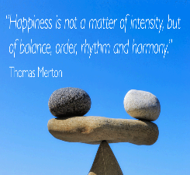
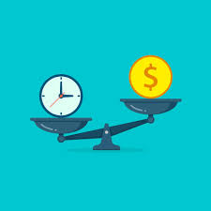
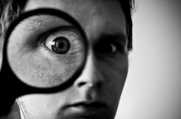
For every trend there is a counter trend and it is critical to understand where are target consumers are positioned across these.
Existing Trends
Evaluating the tension between trends and counter trends
Society evaluating, making sense of the impact and trying to re-balance after the disruption to their personal lives.
Impact of Trend Source
Primary Social Trend
Primary Counter Trend
Secondary Trends & Counter Trends

Slide 12
Identifying key trends into the New Normal

Slide 13
Uncertain world Dramatic shift from a known, familiar, predictable and comfortable world to a world out of control – an unfamiliar world of uncertainty, fear, vulnerability, unpredictability and loss of foundational support structures.
TREND | EFFECT | COUNTER TREND | EFFECT
Re-evaluating and resetting priorities Tempered dreams Creating security Back to Basics Status redefined. | Move to ‘’Simple life, simple pleasures” that we have taken for granted. Tempered dreams with rise in demand for education, skills development, career development Security – Job security, saving, financial planning, budgeting, insurance Living within means, value consciousness Status about respect for those who care for others. | Retro – clinging to familiarity, predictability, comfort Survivalism – “needs must” Revenge Spending – indulgent extravagances Escapism – extreme Carpe Diem – live for the moment. Spiritualism | Retro – food, drinks, recipes, brands ‘’Charity begins at home’ attitude Focus on price, LL, hoarding Indulgences luxuries Extreme behaviour and heightened experiences Increased awareness and move to spirituality and religion Vulnerable groups more reliant on community, family and outside help for survival

Slide 14
Interconnectedness Democratization of illness, uncertainty, financial stress, social impact and insecurity reinforces our interconnectedness and forces us to confront social structures and issues
TREND | EFFECT | COUNTER TREND | EFFECT
Recognition of shared humanity and interdependence Focus on inequality unsustainability Rise of Altruism and ‘’Ubuntu’’ Status redefined. | Appreciation of our shared connectedness, empathy and care for others. Growth of community spirit Rise of altruistic activism Rising consciousness of ‘’health of all’’ Awareness of and support for the ‘’small guy’’ Spotlight on financial inequality and it’s unsustainability Growing distain for overt displays of wealth. | Isolationism - Rising fear of outside world Individualist ‘’Me first’’ attitude -self preservation at the expense of others and the world – e.g. cheap Chinese imports. Rise of Cultural divisions and Xenophobia | ‘’Trump’’ effect, protecting against outside world Focus on home, local is lekker and Nam pride Me, me, me attitude Social tension

Slide 15
Virtual World Acceleration of digital technology as a massive force for good, and evil
TREND | EFFECT | COUNTER TREND | EFFECT
Explosion of digital penetration and usage. Rapid increase in leveraging the amazing potential of digital technology as a force for good | Demand for ever more exciting, new experiences driven by FOMO E Commerce acceleration On-line education development E or TeleHealthCare - Leveraging digital medical technology to diagnose, treat etc Democratization of the best of world experiences Business Transformation – flexibility, work from home, fluid WOW | Explosion and growing awareness of digital fakes, evilness and crime. Focus on privacy Increasingly valuing realness – people, places and experiences. Appreciation for sensory beauty of our natural world. | Restricting connections and time spent on sites. More discerning viewing Need to connect with real people Need for authentic, total sensory experiences (sight & sound + tactility, smell, etc.)

Slide 16
Fragile Earth Recognition of the perilous state of earth, the human impact on her and the urgent need to act before it’s too late.
TREND | EFFECT | COUNTER TREND | EFFECT
Human impact on a fragile earth Human environment interconnectedness Sustainability in focus | Awareness of positive effect of humans stepping back, highlighting our massive impact on a fragile earth Rise of awareness of urgency of saving mother earth with real actions. Growing awareness of and need to reconnect to the natural environment – camping, natural experiences, appreciating beautiful Namibia, gardening, rural migration | Me first - Self preservation before earth | Cheapest wins even if environmentally unfriendly Plastic protects from viruses.

Slide 17
Health and Wellness Renewed focus on our interconnected health and wellness and what it means in the post Covid world
TREND | EFFECT | COUNTER TREND | EFFECT
Hyper sensitivity to contamination Awareness of total health and wellness Rise of ‘’Health of All’’ | Fear for and protection of personal health, particularly in public spaces. Food safety concerns – source, ingredients, production Growing focus on overall health and wellness Growing awareness of our interconnected health and support for ‘’health of all’’ | Invincibility after ‘’surviving Covid’’ Live for today Survivors - Food = health | Extreme behaviour Heightened experiences. Resumption of old habits

Slide 18
Societal and Generational Tension
Rise of a powerful, confident and connected woke generation increasingly questioning and disdainful of the old order versus Governments asserting unilateral power during lockdown.
TREND | EFFECT | COUNTER TREND | EFFECT
New generation questioning old order conventions, norms and economic, political and social cultures. Focus on relationship between Government, business and their roles in society. | Increasing loss of faith in and respect for traditional institutions – Gov, Big Business, leaders etc. Young campaigners gaining global traction and confidence in creating their future Old order forced to confront current beliefs, conventions and social structures Focus on responsibility of business to employees and society | Old order (Government) reasserting power through lockdown and enjoying the taste of it. Focus on individual human rights and freedoms. | Govt vs people tension Generational tension. Business vs people tension Business tension – big business vs entrepreneurs and SME’s

Slide 19
Connecting Dots Discovering Opportunities

Slide 20
Connecting Dots
Post Lockdown Release Period
Emotional desire to reconnect, engage and bond with real people and enjoy real experiences.
Fear for personal health and self protection
Resultant reluctance to frequent restaurants
On line shopping and home delivery persists
Financial Reality
Searching for better value
Release Home socializing occasion
Home socializing and entertainment explosion with good friends and family.
Hartlief, PnP , NBL – home delivery of value driven party packs, beer, mixers, braai meat, snacks, charcoal etc.
Great Tafel moment – re-connecting, sharing, bonding.
Home entertainment promotional and digital opportunity

Slide 21
Connecting Dots
Simple life, simple pleasures
Local is lekker and
Nam Pride
Appreciation of our shared humanity and connectedness
Status Redefined
Looking for more value

Slide 22
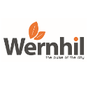
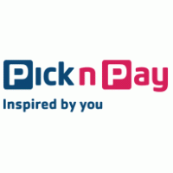
Connecting Dots
On-line shopping growth
Supporting the small guy
Local is lekker and trusted
O&L On-line shopping Hub
On line shopping portal for wide variety of businesses (internal and external) but focused on small businesses and entrepreneurs
Accessible to all – various shopping process from top end (digital, delivered to home) to bottom end (telephonic, brochure choice, Mobipay) delivered to nearest PnP or home.
Distribution by O&L Logistics
Owned and run by O&L
Supported by O&L Digital Hub
Small business support via various COE functions.

Slide 23
Connecting Dots
On-line shopping growth
Want real tactile, human and sensory experiences
Wernhil Tennants – online shopping development
On-line brand experiential shop fronts e.g. YuppieChef
Brand experiential shop fronts for Brands not in Namibia
Wernhil Experiential mall – ‘’Pulse of the City” – on-going exciting, learning, experiencing, discovering activities

Slide 24
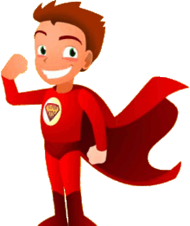
Connecting Dots
Vulnerable groups need support
Interconnectedness and inequality unsustainability
Health for all
On-Line Educational Opportunities
Superkids!
VITAMIN ENRICHED
FULL FAT CULTURED DRINK

Slide 25
Connecting Dots
On Line explosion
Leveraging the power of technology to reach the masses.
Interconnectedness
Recognizing our interdependence - We all win or we all fail
Uncertain World
Education and skills development is the answer to job security in an uncertain world.
O&L Academy
On line teaching, training and capability building hub
In conjunction with Dept of Education – certification
Focus on internal and external education and skills development
Opportunity for both external and internal brand support.

Slide 26
Brand Marketing principles in the new world Some thoughts

Slide 27
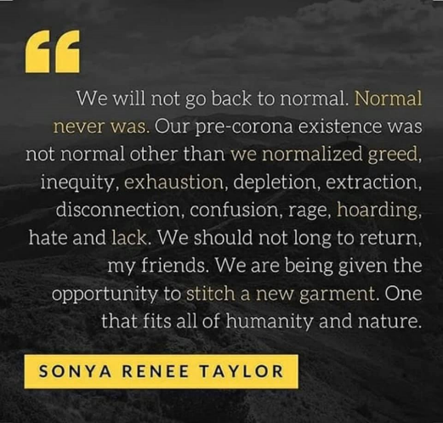
This is an amazing opportunity to let our O&L Purpose guide us into the new world

Slide 28
Brand Marketing Principles in the new normal – what you should do?
Become O&L Purpose driven – let our O&L Purpose guide us in order to create brands with heart that have a clear role in enhancing lives, whether emotionally, functionally or socially.
Become consumer and customer obsessed.
Engage consumers based on deep insights to really connect with their souls
Inspire hope, optimism, light and positivity – everybody is tired of the darkness.
Be authentic - everyone is so over the #brandXcaresaboutyou
Be different – cut through the gratuitous, fake, insincere, self serving ‘’heartfelt’’ clutter.
Become more community driven - us rather than me – brands need to become intimate with and part of community lives.
Focus on action more than just talk.
Co-operate and co-create, build sustainable ecosystems for the good of the people

Slide 29
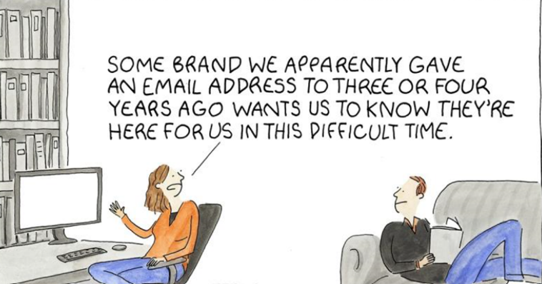
Some thoughts as to Brand Marketing Principles in the new normal – what you should not do?
Never ever take advantage of consumers vulnerable situations
Flaunt an aspirational pretentious, show off world that flies in the face of the downtrodden.
Follow the well worn, tired communication genre started during Lockdown -

Slide 30
Thank You Thoughts, Comments and Questions?

Slide 32
Post-Webinar Survey

Slide 33
Key Trend Descriptions
POST COVID-19 TRENDS
Simple pleasures : Greater appreciation of the simple pleasures in life : things that are crafted, homemade, and have a provenance / Yearning for "good old days" and things that remind us of this
Newer is better : Demand for things and experiences that are new and exciting / stuff is expendable / always looking for new news / Want to be in the know / Chase the latest tech
Spirituality : Increased spirituality : a turn towards religion / spirtual awareness / alternative approaches to life
Extravagence : Conspicious consumption - either as a "spoil me" gesture or as an attempt to seek validation or demonstrating status / revenge-spending / live on credit / disregard the future
Anti-materialism : Reject overt materialism & ambition. Growing disdain for conspicious consumption, greed and overt materialism
Back to Basics : Batten down the hatches : hoarding / saving / only buying essentials / protecting my wealth at all costs
Altruism : Greater sense of altruism / community spirit / Ubuntu
Me-me-me : Growth in individualism : "me first" and stuff everybody else / look after, and protect me and my family first
Us vs them : Growing divisions in society : race / culture / ageism / class distinctions / growing xenophobia
Togetherness : Growth in community / societal support : "we're in this together"
Lock out the world : Increased isolationism - both as individuals / family units, and as a country
Local is lekker : Increased support for "the small guy" / Active rejection of Big Business / searching out local goods & services
Bigger is better : disregard for small enterprise / cheaper is better / rise of imports / return of the mega-mall
Healthy me : Increased focus on personal health and protection / Get into the exercise routine
Carpe Diem : "Live in the moment" : rise in risky behaviour / hedonism / sex, drugs & rock & roll / disregard for consequences of my actions
One Earth : Growing awareness of the impact we have on the environment, and willing to make sacrifices to protect the earth
Stuff the planet : disregard for the impact I have on the environment / indifferent to the wellfare of the planet "Let's get the economy started regardless of the cost to the environment" / apathy owards recycling & the conscious consumption / protecting the environment is someone else's problem / reckless exploitation of resources and the environment.
Digital me : Exponential growth in living a digital life : e-commerce / online shopping / virtual meetings / online schooling / digital escapism
Technosaurus : Rejection of a digital world : fake news / digital & news overload / yearning for physical connections / fear of the power of a digitised world
Back to nature : Growing need to connect to nature
Bright City lights : The New Joller : looking for nightclubs / disco-rave / bars / socialising on the edge / yearning for social interaction & connections
Amandla : Increased resistance to authority : questioning government & authority figures / increased protests / Demands for accountability and greater personal freedoms
Big Brother : Rise of the securocrats : prolonged abuse of powers gained during emergency & lack of accountability / consumers accept limitations of freedoms / No objections to "police state" tactics / Support for stronger (autocratic) rule of the law

Slide 34
Key trends : Likely vs Impact

